Slide 1
Database Recovery & Security Management
Unit-6

Slide 2
Topics to be covered
Database recovery
Types of failures
Storage structure
Volatile
Non-volatile
Stable storage
Data access
Recovery and atomicity

Slide 3
Recovery techniques algorithms
Log based recovery
Check points
Shadow paging
Recovery with concurrent transactions
Failures with loss of non volatile storages
Basic data security principles
User privileges
Data masking
Encryption
Decryption
Data security implementation

Slide 4
Database Recovery
Database Recovery is the process of restoring the database and the data to a consistent state. This may include restoring lost data up to the point of the event (e.g. system crash).
OR
Data recovery is the process of restoring data that has been lost, accidentally deleted, corrupted or made inaccessible for any reason.

Slide 5
Failure Classification : There are many types of failures that can effect database processing:
Transaction failure :
Logical errors: transaction cannot complete due to some internal error condition
System errors: the database system must terminate an active transaction due to an error condition (e.g., deadlock)
System crash: a power failure or other hardware or software failure causes the system to crash.
Fail-stop assumption: non-volatile storage contents are assumed to not be corrupted by system crash
Database systems have numerous integrity checks to prevent corruption of disk data

Slide 6
Disk failure: a head crash or similar disk failure destroys all or part of disk storage
Destruction is assumed to be detectable: disk drives use checksums to detect failures
Natural Physical Disasters : These are floods, earthquake or power failures.
Network failure: Network failure can occur while using client server configuration. Where multiple database servers are connected to the network.

Slide 7
Recovery Algorithms
Recovery algorithms are techniques to ensure database consistency and transaction atomicity and durability despite failures
Focus of this chapter
Recovery algorithms have two parts
Actions taken during normal transaction processing to ensure enough information exists to recover from failures
Actions taken after a failure to recover the database contents to a state that ensures atomicity, consistency and durability

Slide 8
Log-Based Recovery
Log is a sequence of records, which maintains the records of actions performed by a transaction. It is important that the logs are written prior to the actual modification and stored on a stable storage media, which is failsafe.
Log-based recovery works as follows −
The log file is kept on a stable storage media.
When a transaction enters the system and starts execution, it writes a log about it.

Slide 9
Log-Based Recovery
A log is kept on stable storage.
The log is a sequence of log records, and maintains a record of update activities on the database.
When transaction T_{i} starts, it registers itself by writing a <T_{i} start>log record
Before T_{i} executes write(X), a log record <T_{i}, X, V₁, V₂> is written, where V₁ is the value of X before the write, and V₂ is the value to be written to X.
Log record notes that T_{i} has performed a write on data item X_{j} X_{j} had value V₁ before the write, and will have value V₂ after the write.
When T_{i} finishes it last statement, the log record <T_{i} commit> is written.
We assume for now that log records are written directly to stable storage (that is, they are not buffered)
Two approaches using logs
Deferred database modification
Immediate database modification

Slide 10
The deferred database modification scheme records all modifications to the log, but defers all the writes to after partial commit.
deferred update is to defer or postpone any actual updates to the database itself until the transaction completes its execution successfully and reaches its commit point. During transaction execution, the updates are recorded only in the log and in the transaction workspace. After the transaction reaches its commit point and the log is force-written to disk, the updates are recorded in the database itself. If a transaction fails before reaching its commit point, there is no need to undo any operations, because the transaction has not affected the database in any way.

Slide 11
The steps involved in the deferred update protocol are as follows:
When a transaction starts, write an entry start_transaction(T) to the log.
When any operation is performed that will change values in the database, write a log entry write_item(T, x, old_value, new_value).
When a transaction is about to commit, write a log record of the form commit(T); write all log records to disk.
Commit the transaction, using the log to write the updates to the database; the writing of data to disk need not occur immediately.
If the transaction aborts, ignore the log records and do not write the changes to disk.

Slide 12
Deferred Database Modification
Assume that transactions execute serially
Transaction starts by writing <T_{i} start> record to log.
A write(X) operation results in a log record <T_{i}, X, V> being written, where V is the new value for X
Note: old value is not needed for this scheme
The write is not performed on X at this time, but is deferred.
When T_{i} partially commits, <T_{i} commit> is written to the log
Finally, the log records are read and used to actually execute the previously deferred writes.

Slide 13
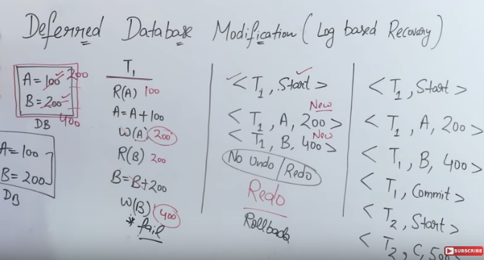

Slide 14
Deferred Database Modification (Cont.)
During recovery after a crash, a transaction needs to be redone if and only if both <T_{i} start> and<T_{i} commit> are there in the log.
Redoing a transaction T_{i} ( redoT_{i}) sets the value of all data items updated by the transaction to the new values.
Crashes can occur while
the transaction is executing the original updates, or
while recovery action is being taken

Slide 15
Immediate Database Modification
The immediate database modification scheme allows database updates of an uncommitted transaction to be made as the writes are issued
since undoing may be needed, update logs must have both old value and new value
Update log record must be written before database item is written
We assume that the log record is output directly to stable storage
Can be extended to postpone log record output, so long as prior to execution of an output(B) operation for a data block B, all log records corresponding to items B must be flushed to stable storage
Output of updated blocks can take place at any time before or after transaction commit
Order in which blocks are output can be different from the order in which they are written.

Slide 16
In the immediate update techniques, the database may be updated by the operations of a transaction immediately, before the transaction reaches its commit point. However, these operations are typically recorded in the log on disk by force-writing before they are applied to the database, so that recovery is possible.
When a transaction starts, write an entry start_transaction(T) to the log;
When any operation is performed that will change values in the database, write a log entry write_item(T, x, old_value, new_value);
Write the log to disk;
Once the log record is written, write the update to the database buffers;
When convenient, write the database buffers to the disk;
When a transaction is about to commit, write a log record of the form commit(T);
Write the log to disk

Slide 17
Immediate Database Modification (Cont.)
Recovery procedure has two operations instead of one:
undo(T_{i}) restores the value of all data items updated by T_{i} to their old values, going backwards from the last log record for T_{i}
redo(T_{i}) sets the value of all data items updated by T_{i} to the new values, going forward from the first log record for T_{i}
Both operations must be idempotent
That is, even if the operation is executed multiple times the effect is the same as if it is executed once
Needed since operations may get re-executed during recovery
When recovering after failure:
Transaction T_{i} needs to be undone if the log contains the record <T_{i} start>, but does not contain the record <T_{i} commit>.
Transaction T_{i} needs to be redone if the log contains both the record <T_{i} start> and the record <T_{i} commit>.
Undo operations are performed first, then redo operations.

Slide 18
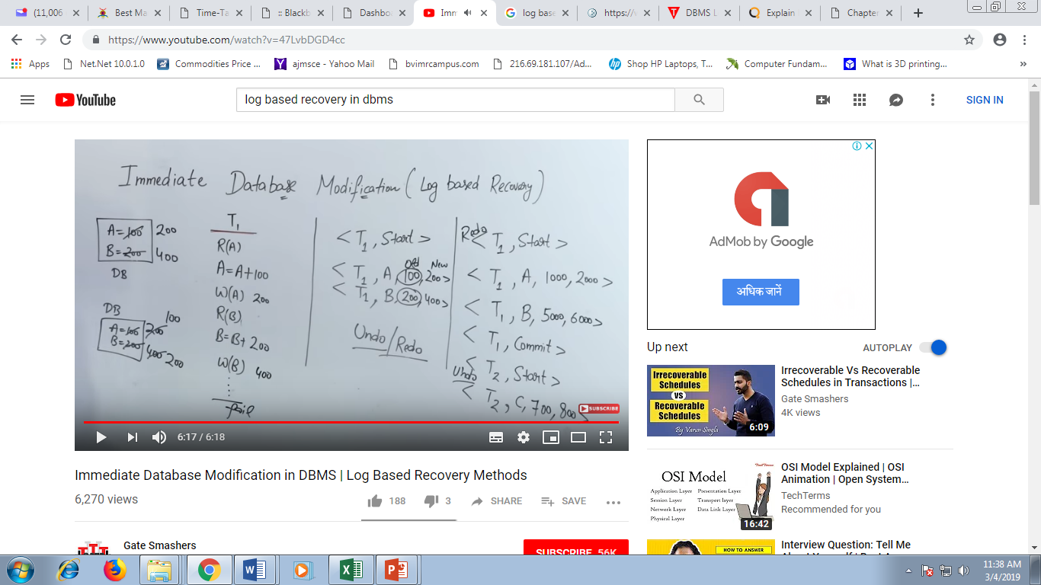
Explain:

Slide 19
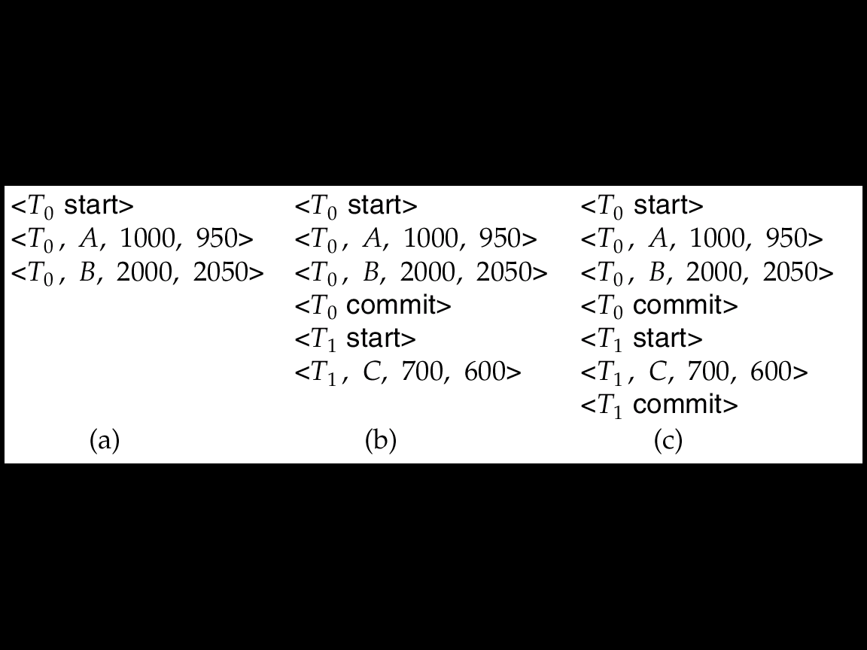
Immediate DB Modification Recovery Example
Below we show the log as it appears at three instances of time.
Recovery actions in each case above are:
(a) undo (T₀): B is restored to 2000 and A to 1000.
(b) undo (T₁) and redo (T₀): C is restored to 700, and then A and B are
set to 950 and 2050 respectively.
(c) redo (T₀) and redo (T₁): A and B are set to 950 and 2050
respectively. Then C is set to 600

Slide 20
Recovery and Atomicity
When a system crashes, it should have many transactions being executed and numerous files opened for them to switch the information items. Transactions are a product of numerous operations that are atomic in nature. However consistent with ACID properties of a database, atomicity of transactions as an entire should be maintained, that is, either all the operations are executed or none.
When a database management system recovers from a crash, it ought to maintain the subsequent:
It ought to check the states of all the transactions that were being executed.
A transaction could also be within the middle of some operation; the database management system should make sure the atomicity of the transaction during this case.
It ought to check whether or not the transaction is completed currently or it must be rolled back.
No transactions would be allowed to go away from the database management system in an inconsistent state.

Slide 21
Recovery and Atomicity
There are 2 forms of techniques, which may facilitate a database management system in recovering as well as maintaining the atomicity of a transaction:
Maintaining the logs of every transaction, and writing them onto some stable storage before truly modifying the info.
Maintaining shadow paging, wherever the changes are done on a volatile memory, and later, and the particular info is updated.

Slide 22
Recovery and Atomicity (Cont.)
Modifying the database without ensuring that the transaction will commit may leave the database in an inconsistent state.
Consider transaction T_{i} that transfers $50 from account A to account B; goal is either to perform all database modifications made by T_{i} or none at all.
Several output operations may be required for T_{i} (to output A and B). A failure may occur after one of these modifications have been made but before all of them are made.
To ensure atomicity despite failures, we first output information describing the modifications to stable storage without modifying the database itself.
We study two approaches:
log-based recovery, and
shadow-paging
We assume (initially) that transactions run serially, that is, one after the other.

Slide 23
Checkpoints
Keeping and maintaining logs in real time and in real environment may fill out all the memory space available in the system. As time passes, the log file may grow too big to be handled at all. Checkpoint is a mechanism where all the previous logs are removed from the system and stored permanently in a storage disk. Checkpoint declares a point before which the DBMS was in consistent state, and all the transactions were committed.

Slide 24
When it reaches to the checkpoint, then the transaction will be updated into the database, and till that point, the entire log file will be removed from the file. Then the log file is updated with the new step of transaction till next checkpoint and so on.
The checkpoint is used to declare a point before which the DBMS was in the consistent state, and all transactions were committed.

Slide 25
Checkpoints
Problems in recovery procedure as discussed earlier :
searching the entire log is time-consuming
we might unnecessarily redo transactions which have already output their updates to the database.
Streamline recovery procedure by periodically performing checkpointing
Output all log records currently residing in main memory onto stable storage.
Output all modified buffer blocks to the disk.
Write a log record < checkpoint> onto stable storage.

Slide 26
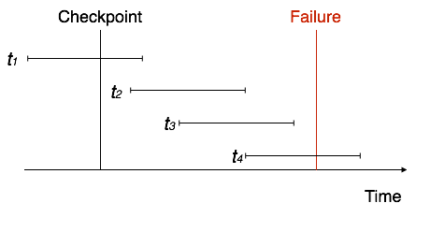
Recovery When a system with concurrent transactions crashes and recovers, it behaves in the following manner −

Slide 27
The recovery system reads the logs backwards from the end to the last checkpoint.
• It maintains two lists, an undo-list and a redo-list.
• If the recovery system sees a log with <tn, start=""> and <tn, commit=""> or just <tn, commit="">, it puts the transaction in the redo-list.
• If the recovery system sees a log with <tn, start=""> but no commit or abort log found, it puts the transaction in undo-list.
• All the transactions in the undo-list are then undone and their logs are removed.
• All the transactions in the redo-list and their previous logs are removed and then redone before saving their logs.

Slide 29
Shadow Paging
Shadow paging is an alternative to log-based recovery; this scheme is useful if transactions execute serially
Idea: maintain two page tables during the lifetime of a transaction –the current page table, and the shadow page table
Store the shadow page table in nonvolatile storage, such that state of the database prior to transaction execution may be recovered.
Shadow page table is never modified during execution
To start with, both the page tables are identical. Only current page table is used for data item accesses during execution of the transaction.
Whenever any page is about to be written for the first time
A copy of this page is made onto an unused page.
The current page table is then made to point to the copy
The update is performed on the copy

Slide 30
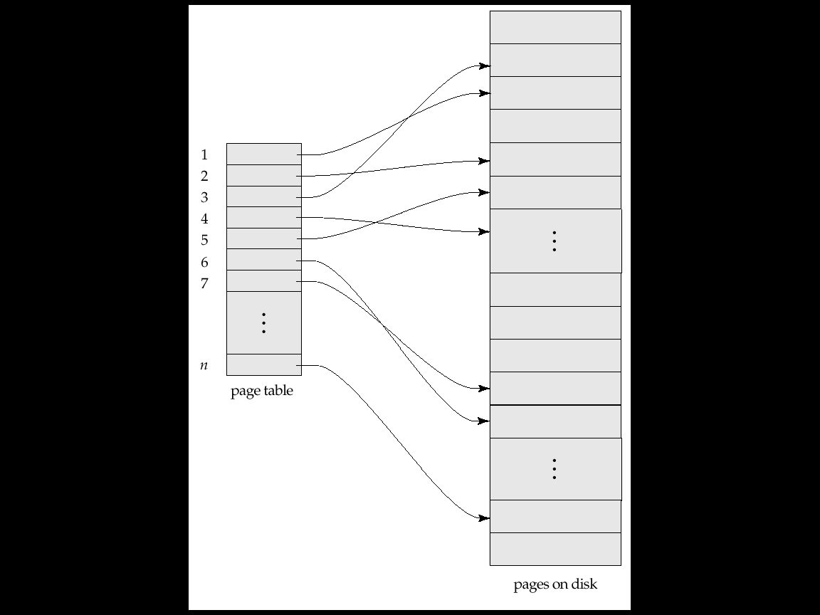
Sample Page Table

Slide 31
Shadow Paging (Cont.)
To commit a transaction :
1. Flush all modified pages in main memory to disk
2. Output current page table to disk
3. Make the current page table the new shadow page table, as follows:
keep a pointer to the shadow page table at a fixed (known) location on disk.
to make the current page table the new shadow page table, simply update the pointer to point to current page table on disk
Once pointer to shadow page table has been written, transaction is committed.
No recovery is needed after a crash — new transactions can start right away, using the shadow page table.
Pages not pointed to from current/shadow page table should be freed (garbage collected).

Slide 32
Show Paging (Cont.)
Advantages of shadow-paging over log-based schemes
no overhead of writing log records
recovery is insignificant
Disadvantages :
Copying the entire page table is very expensive
Can be reduced by using a page table structured like a B⁺-tree
No need to copy entire tree, only need to copy paths in the tree that lead to updated leaf nodes
Commit overhead is high even with above extension
Need to flush every updated page, and page table
Data gets fragmented (related pages get separated on disk)
After every transaction completion, the database pages containing old versions of modified data need to be garbage collected
Hard to extend algorithm to allow transactions to run concurrently
Easier to extend log based schemes

Slide 33
Recovery With Concurrent Transactions
We modify the log-based recovery schemes to allow multiple transactions to execute concurrently.
All transactions share a single disk buffer and a single log
A buffer block can have data items updated by one or more transactions

Slide 34
Recovery With Concurrent Transactions
We assume concurrency control using strict two-phase locking;
i.e. the updates of uncommitted transactions should not be visible to other transactions
Otherwise how to perform undo if T1 updates A, then T2 updates A and commits, and finally T1 has to abort?

Slide 35
Recovery With Concurrent Transactions
Logging is done as described earlier.
Log records of different transactions may be interspersed in the log.
The checkpointing technique and actions taken on recovery have to be changed
since several transactions may be active when a checkpoint is performed.

Slide 36
Recovery With Concurrent Transactions (Cont.)
Checkpoints are performed as before, except that the checkpoint log record is now of the form < checkpoint L> where L is the list of transactions active at the time of the checkpoint
We assume no updates are in progress while the checkpoint is carried out (will relax this later)
When the system recovers from a crash, it first does the following:
Initialize undo-list and redo-list to empty
Scan the log backwards from the end, stopping when the first <checkpoint L> record is found. For each record found during the backward scan:
if the record is <T_{i} commit>, add T_{i} to redo-list
if the record is <T_{i} start>, then if T_{i} is not in redo-list, add T_{i} to undo-list
For every T_{i} in L, if T_{i} is not in redo-list, add T_{i} to undo-list

Slide 37
Data Access
Any access to the stored data is done by the data manager. A user's request for data is-received by the data manager, which determ1ines the physical record required.
The file manager decides which physical block of secondary storage devices contains the required record and sends the request for the appropriate block to the disk manager. A block is a unit of physical input/output operations between primary and secondary storage

Slide 38
Physical blocks are those blocks residing on the disk.
Buffer blocks are the blocks residing temporarily in main memory.
Block movements between disk and main memory are initiated through the following two operations:
input(B) transfers the physical block B to main memory.
output(B) transfers the buffer block B to the disk, and replaces the appropriate physical block there.
Each transaction T_{i} has its private work-area in which local copies of all data items accessed and updated by it are kept.

Slide 39
Data Access (Cont.)
Transaction transfers data items between system buffer blocks and its private work-area using the following operations :
read(X) assigns the value of data item X to the local variable x_{i}.
write(X) assigns the value of local variable x_{i} to data item {X} in the buffer block.
both these commands may necessitate the issue of an input(B_{X}) instruction before the assignment, if the block B_{X} in which X resides is not already in memory.
Transactions
Perform read(X) while accessing X for the first time;
All subsequent accesses are to the local copy.
After last access, transaction executes write(X).
output(B_{X}) need not immediately follow write(X). System can perform the output operation when it deems fit.

Slide 40
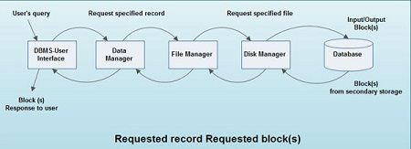

Slide 41
Storage Structure
Volatile storage:
does not survive system crashes
examples: main memory, cache memory
Nonvolatile storage:
survives system crashes
examples: disk, tape, flash memory, non-volatile (battery backed up) RAM
Stable storage:
a mythical form of storage that survives all failures
approximated by maintaining multiple copies on distinct nonvolatile media

Slide 42
Example of Recovery
Go over the steps of the recovery algorithm on the following log:
<T₀ start>
<T₀, A, 0, 10>
<T₀ commit>
<T₁ start>
<T₁, B, 0, 10>
<T₂ start> /* Scan in Step 4 stops here */
<T₂, C, 0, 10>
<T₂, C, 10, 20>
<checkpoint {T₁, T₂}>
<T₃ start>
<T₃, A, 10, 20>
<T₃, D, 0, 10>
<T₃ commit>

Slide 43
Basic data security principles
User privileges
Data masking
Encryption
Decryption
Data security implementation

Slide 44
User privileges
A user privilege is a right to execute a particular type of SQL statement, or a right to access another user's object.
The types of privileges are defined by Oracle.
Roles, on the other hand, are created by users (usually administrators) and are used to group together privileges or other roles.

Slide 45
Data masking
Data masking is a method of creating a structurally similar but false version of an organization's data that can be used for purposes such as software testing and user training.
The purpose is to protect the actual data while having a functional substitute for occasions when the real data is not required.

Slide 46
Encryption
Encryption is the most effective way to achieve data security.
To read an encrypted file, you must have access to a secret key or password that enables you to decrypt it.
Unencrypted data is called plain text ;encrypted data is referred to as cipher text.

Slide 47
Decryption
Decryption is the process of taking encoded or encrypted text or other data and converting it back into text that you or the computer can read and understand.

